Slide 1

CUI Abbottabad
Department of Computer Science
SRE
17
Decision Table

Slide 2
Outline
Decision Tree and Table

Slide 3
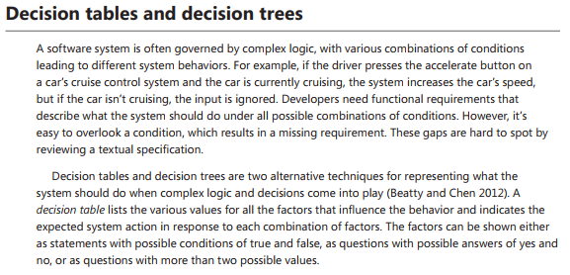

Slide 4
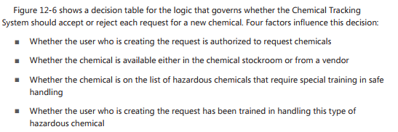

Slide 5
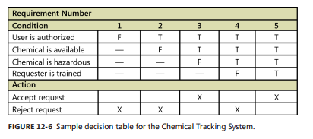

Slide 6
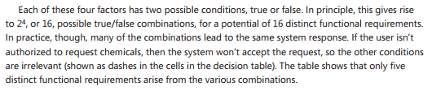

Slide 7
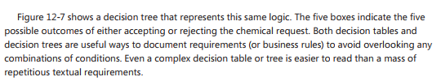

Slide 8
